Slide 1
Observational Study of Convective Events Delaying Flight Operations at the Atlanta Hartsfield
International Airport
Celeste H. Moreno and Curtis N. James
Applied Meteorology / Embry Riddle Aeronautical University / Prescott, Arizona

Slide 2
Overview
The synoptic weather patterns and thermodynamic properties of each type of event will be analyzed and are presented by superposed epoch analysis (or composites) of NCEP gridded synoptic re-analysis data.
Southbound Squalls
Eastbound Squalls
Eastbound Scattered
Eastbound organizing
Northbound organizing
Inconsistencies

Slide 3
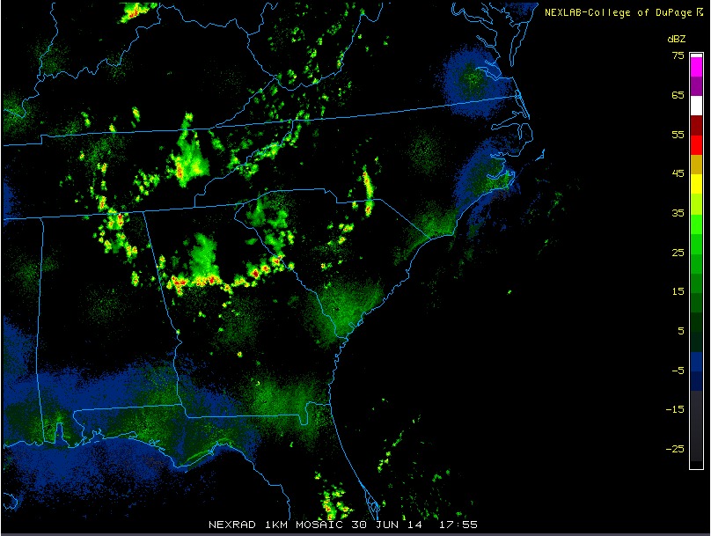
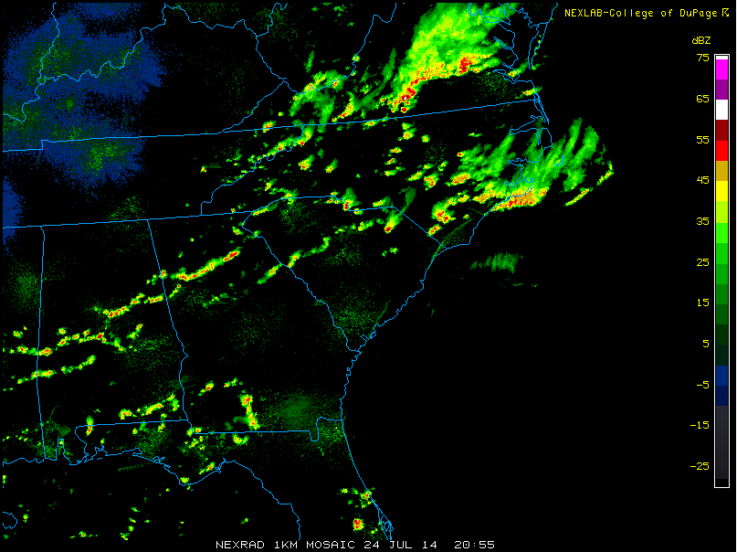
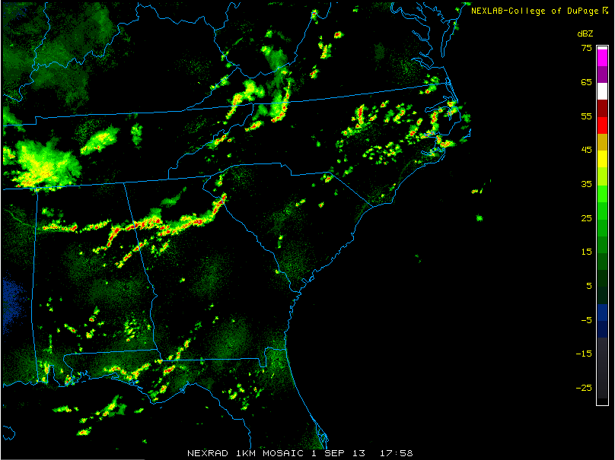
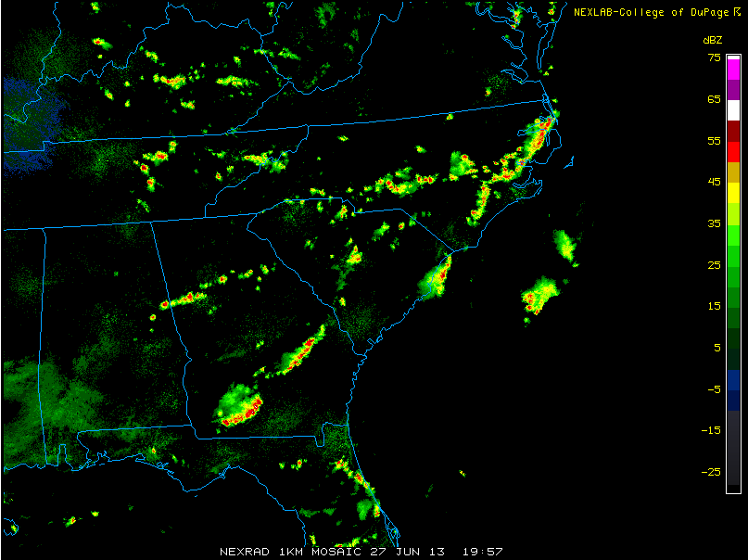
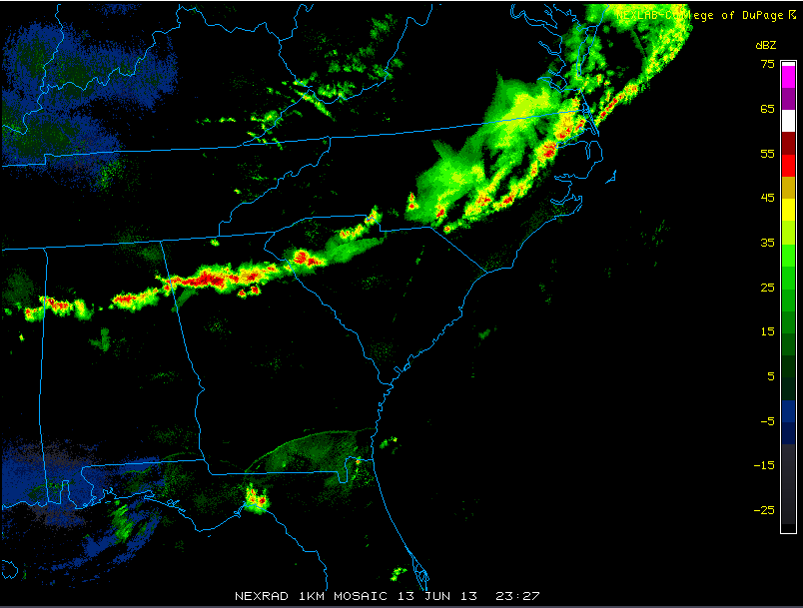
Southbound Squalls
Synoptic Weather Characteristics
159 Delays
201 Delays
152 Delays
173 Delays
277 Delays

Slide 4
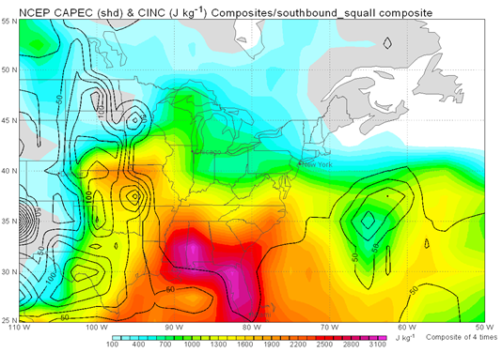
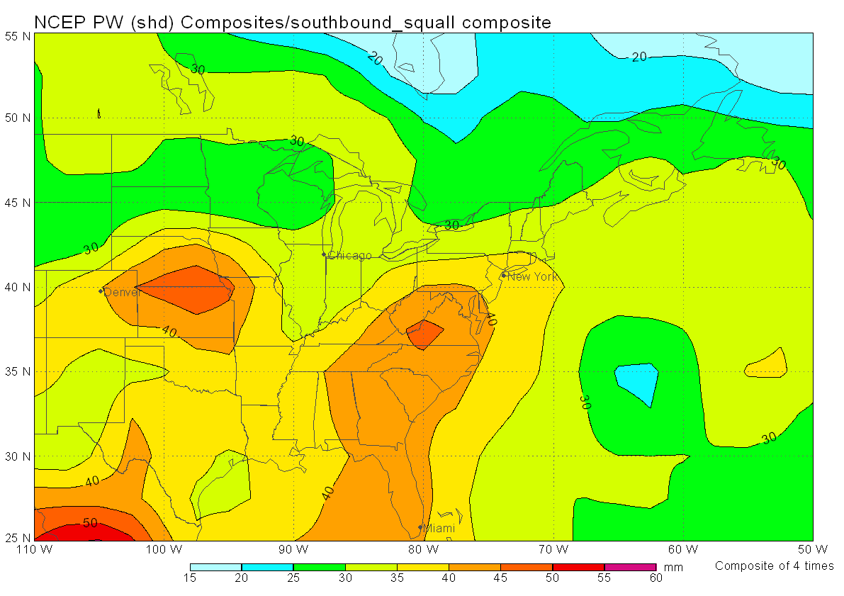
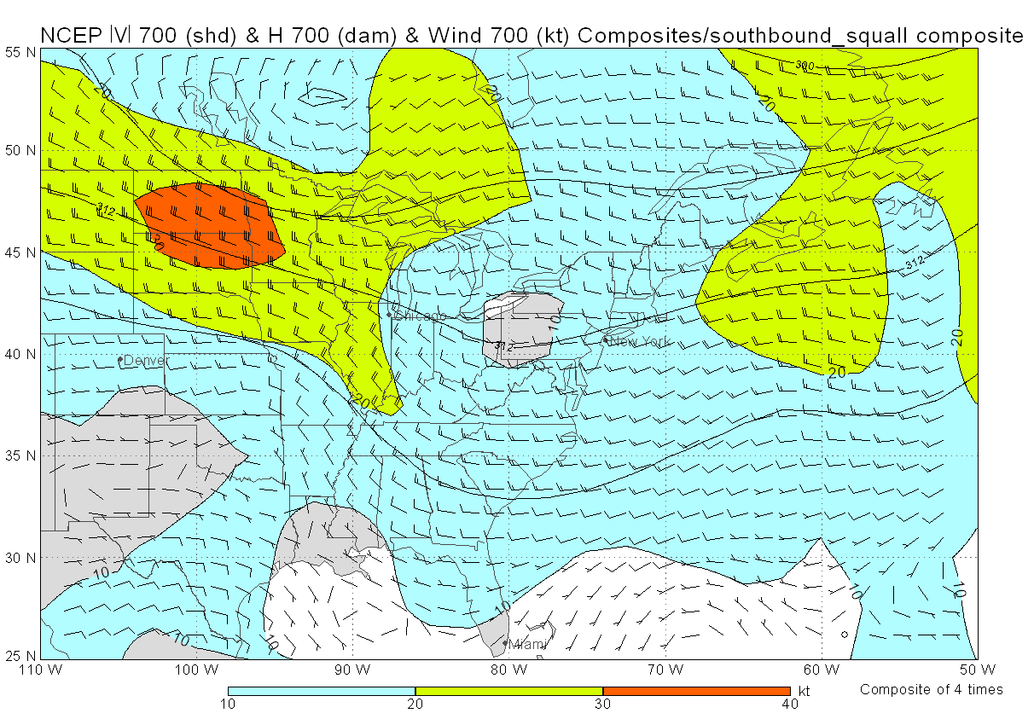
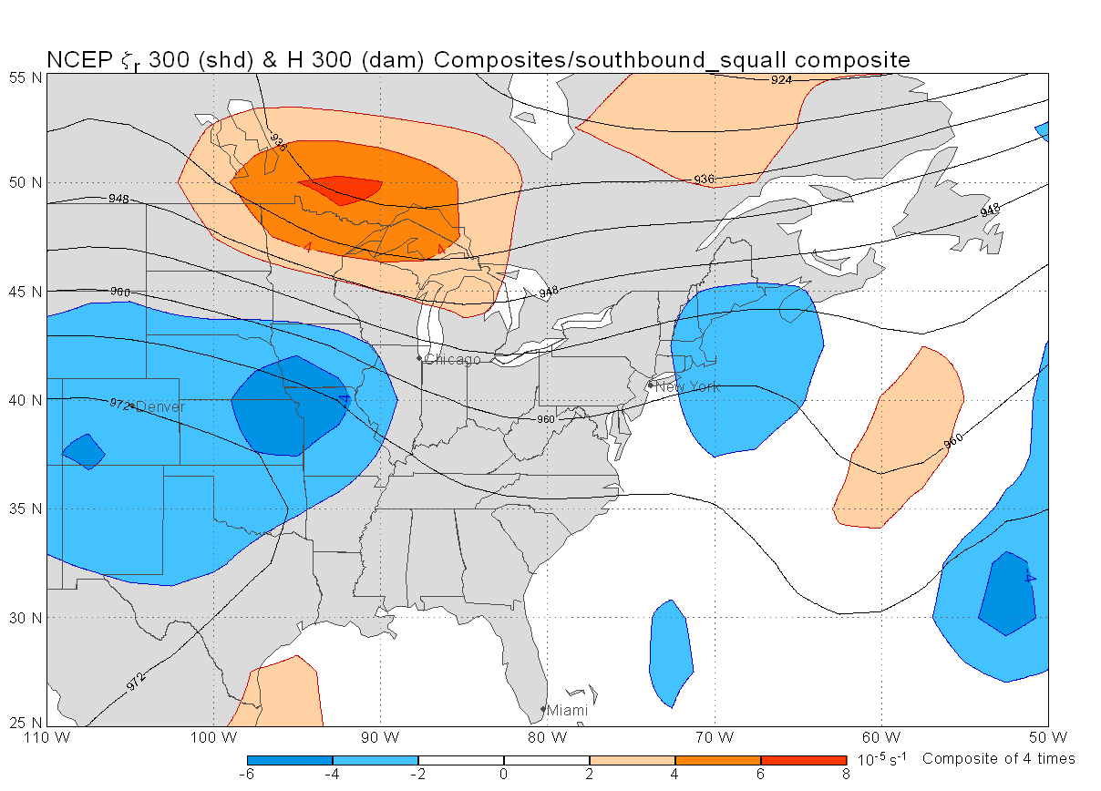
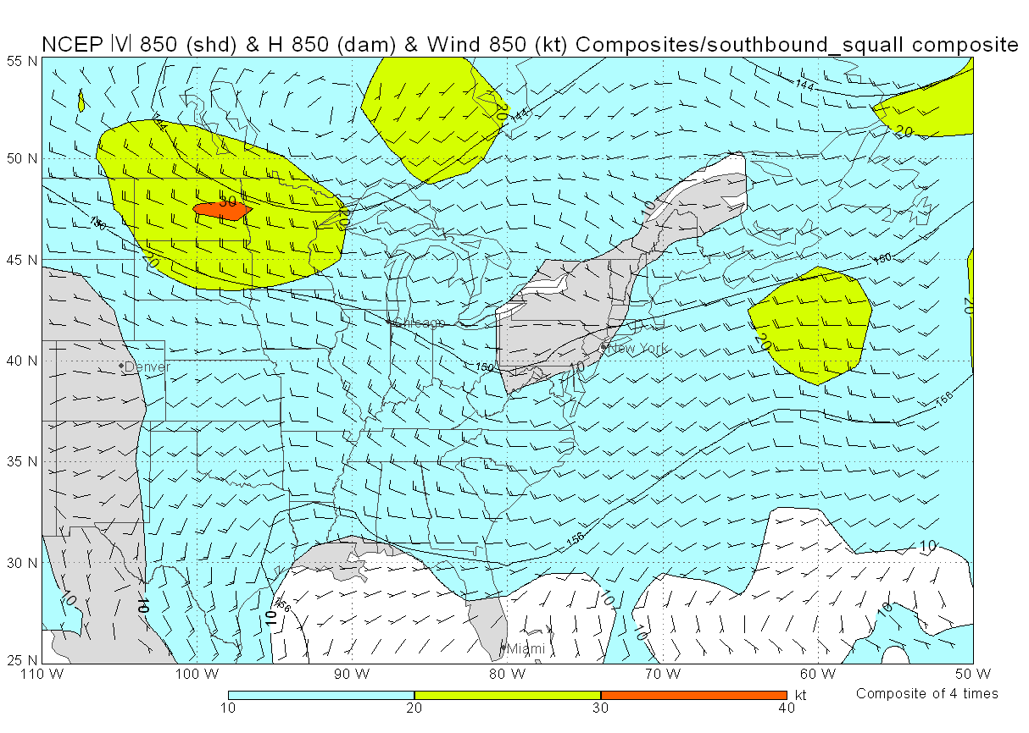
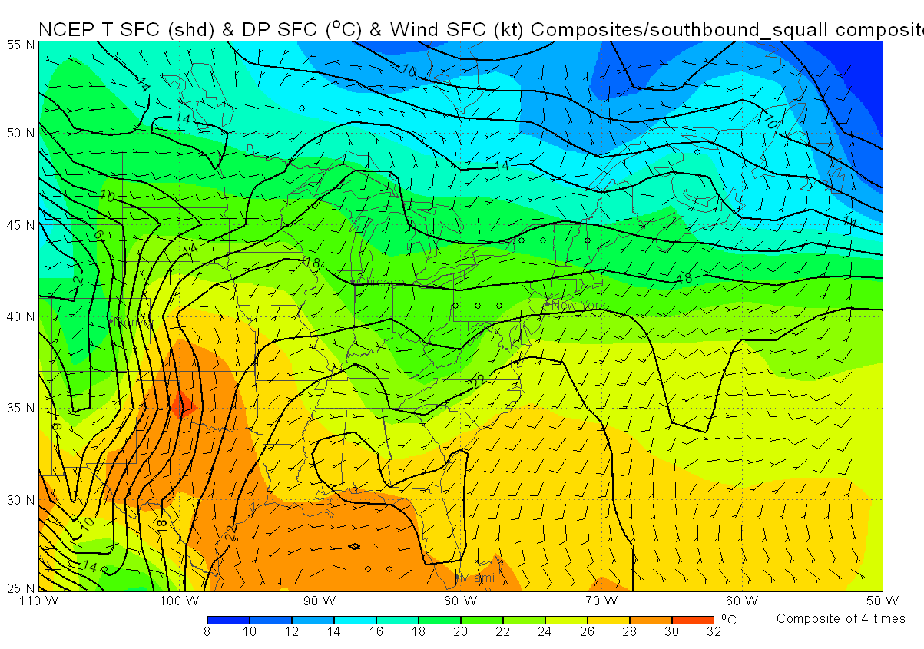
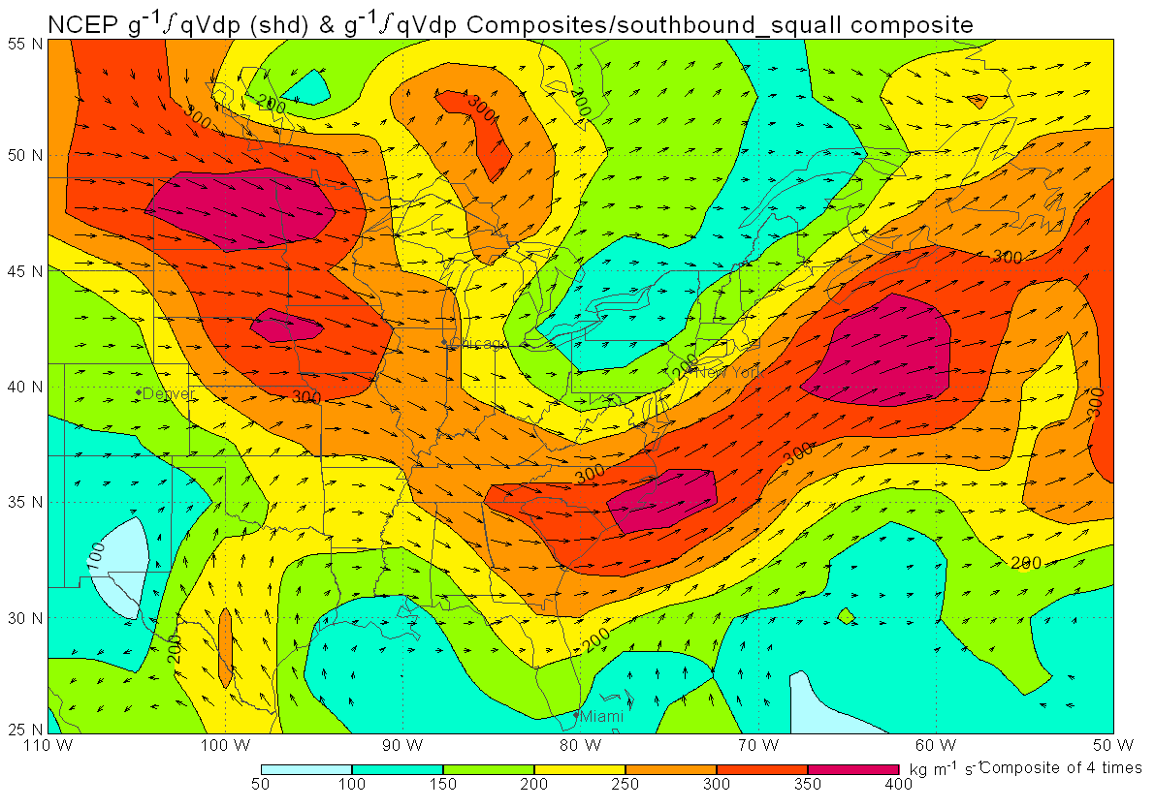
Southbound Squalls
Synoptic Weather Characteristics (Continued)

Slide 5
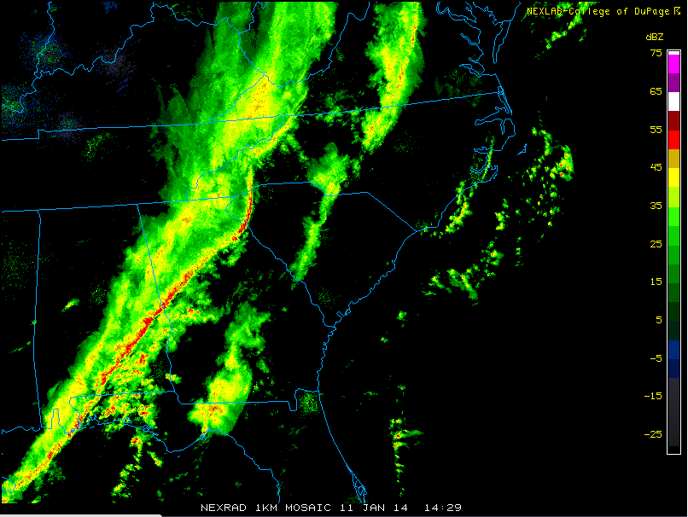
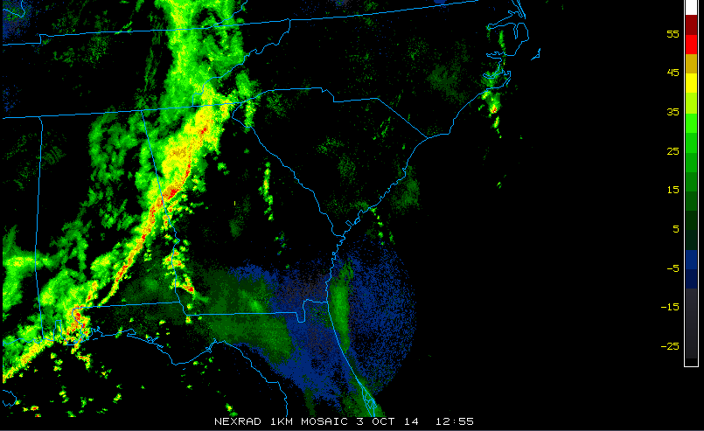
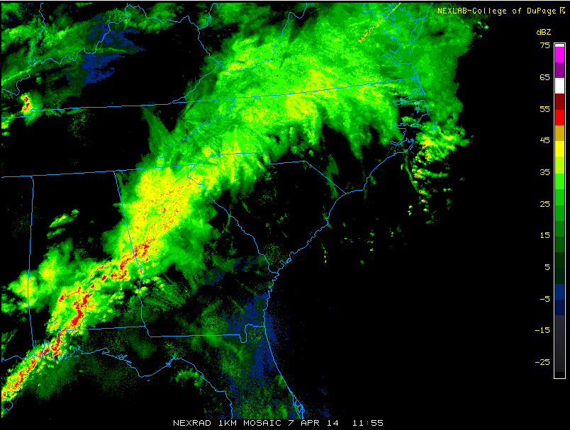
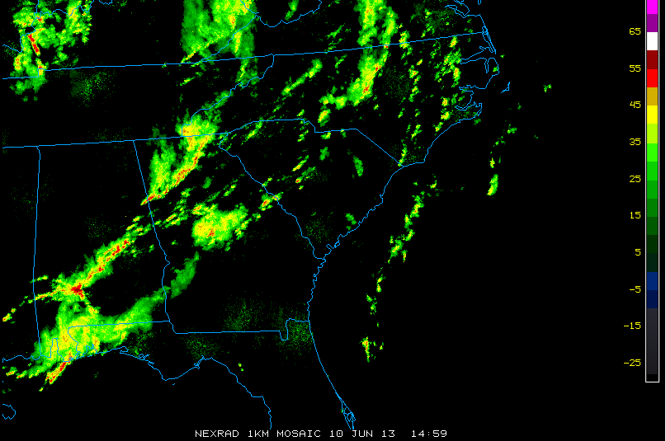
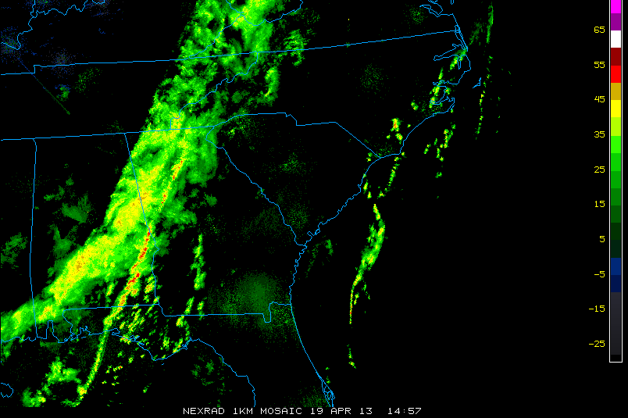
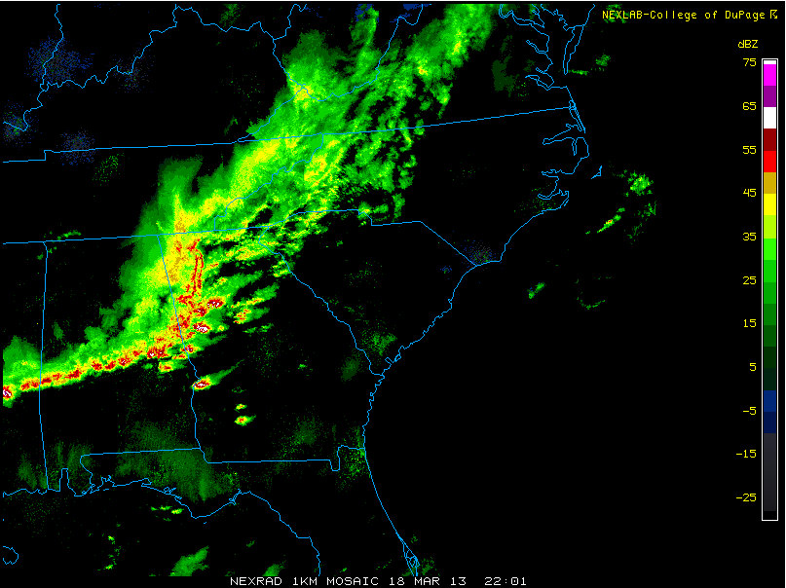
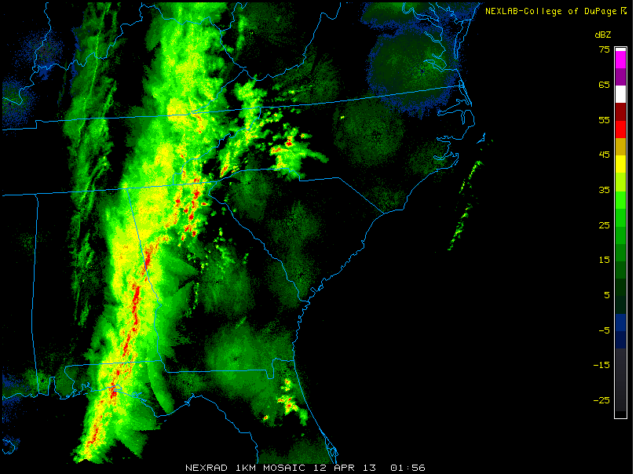
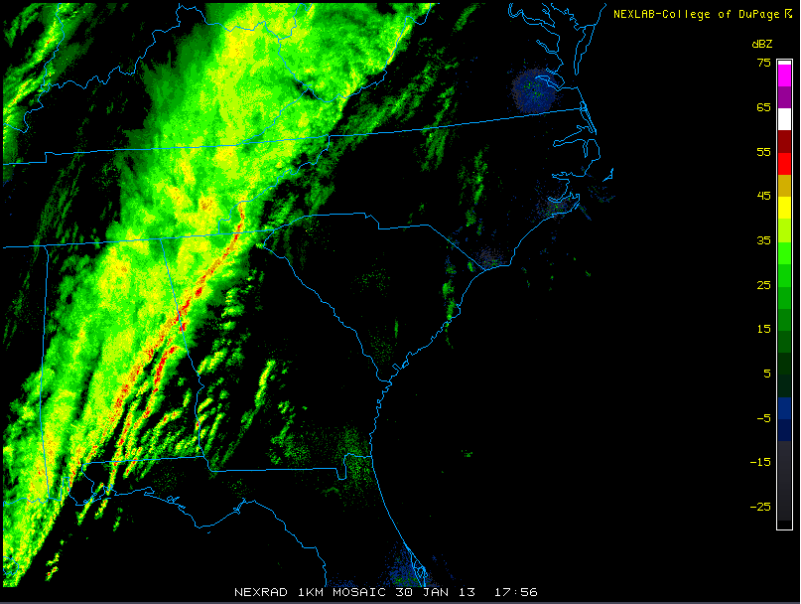
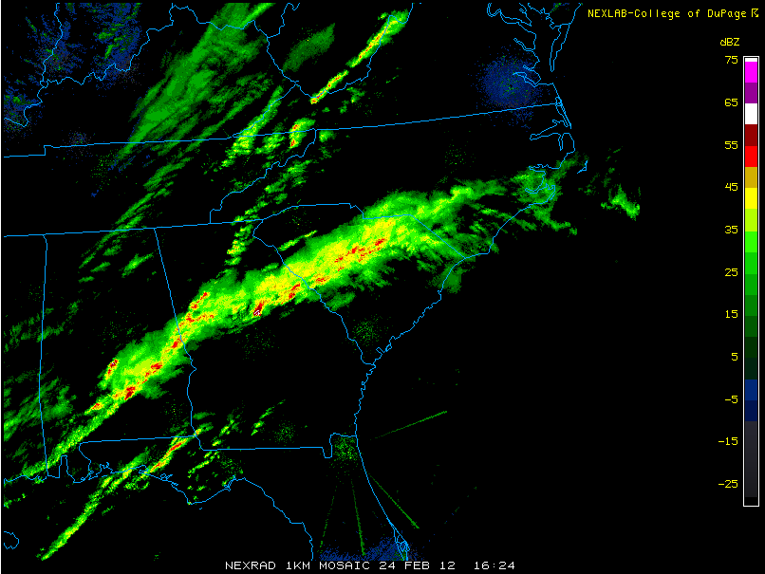
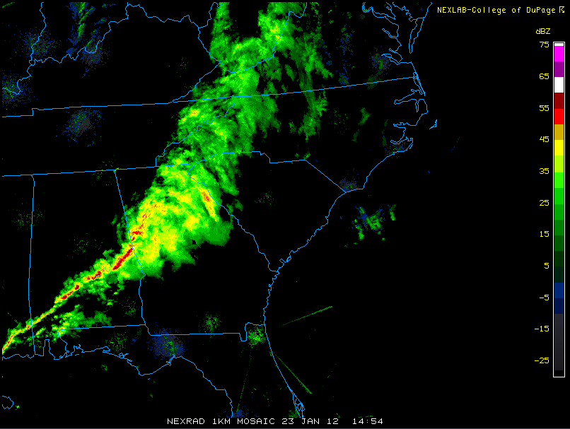
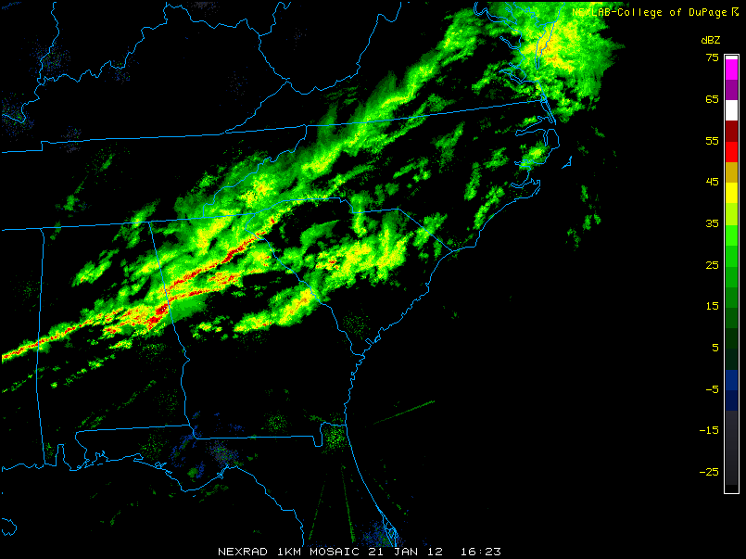
Eastbound Squall
Synoptic Weather Characteristics
186 Delays
281 Delays
329 Delays
103 Delays
135 Delays
271 Delays
287 Delays
582 Delays
245 Delays
452 Delays
178 Delays

Slide 6
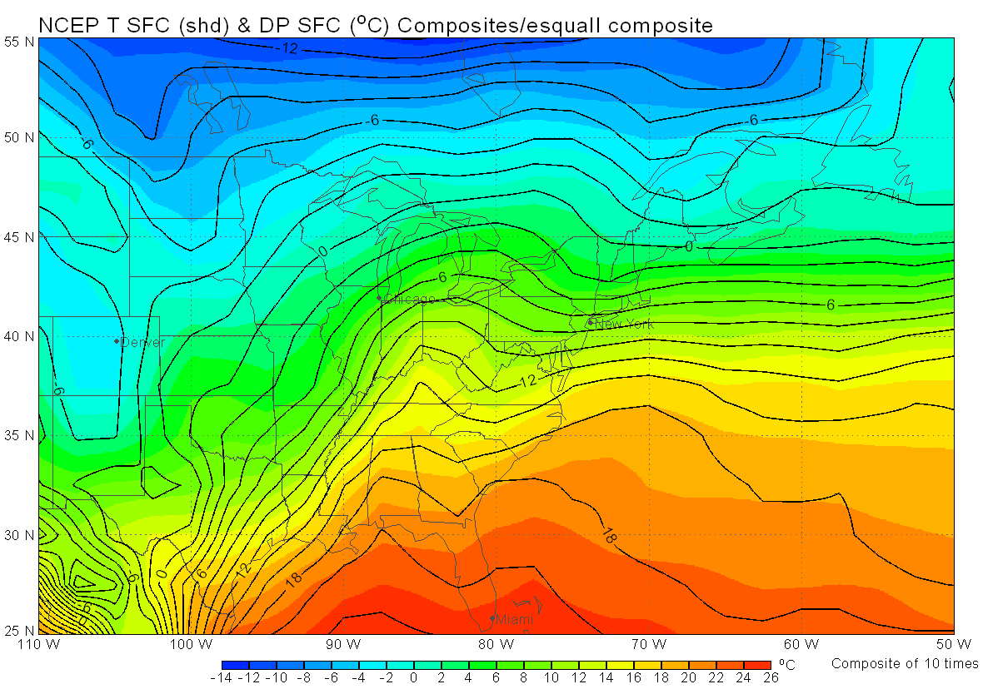
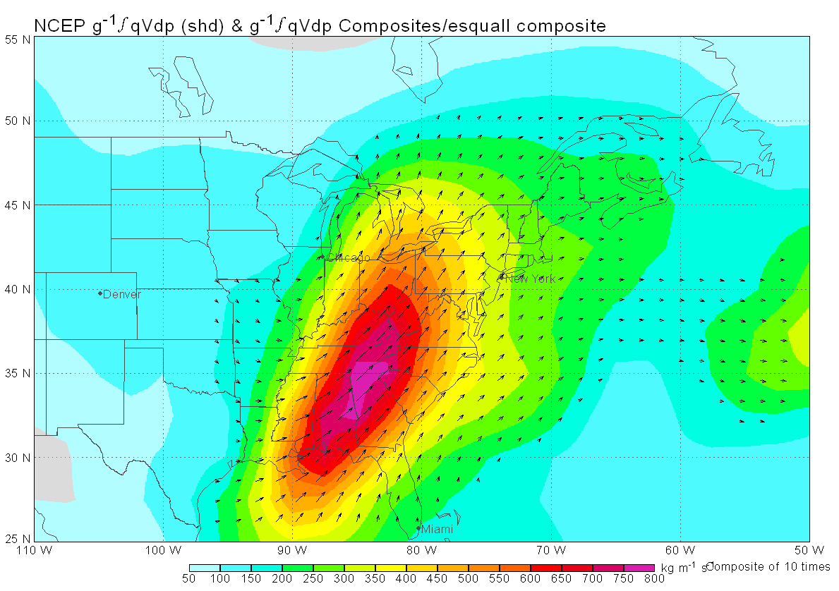
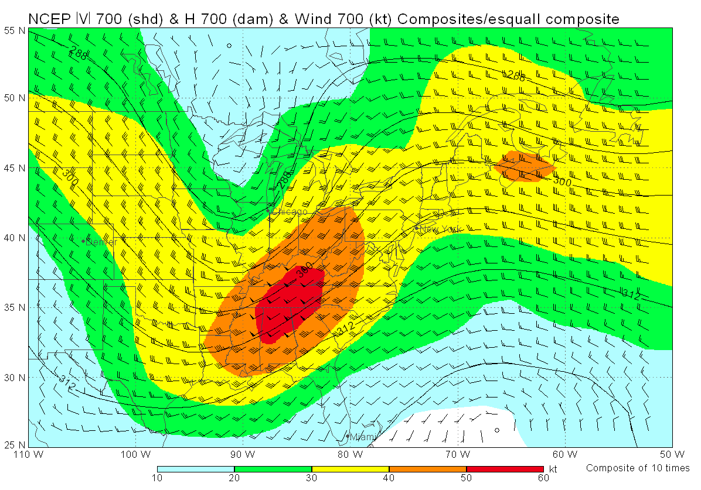
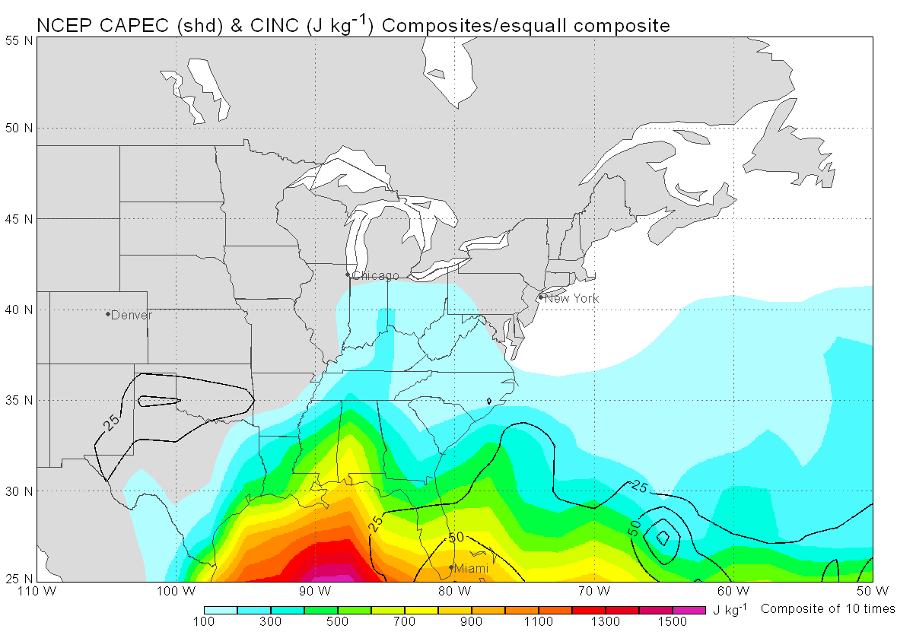
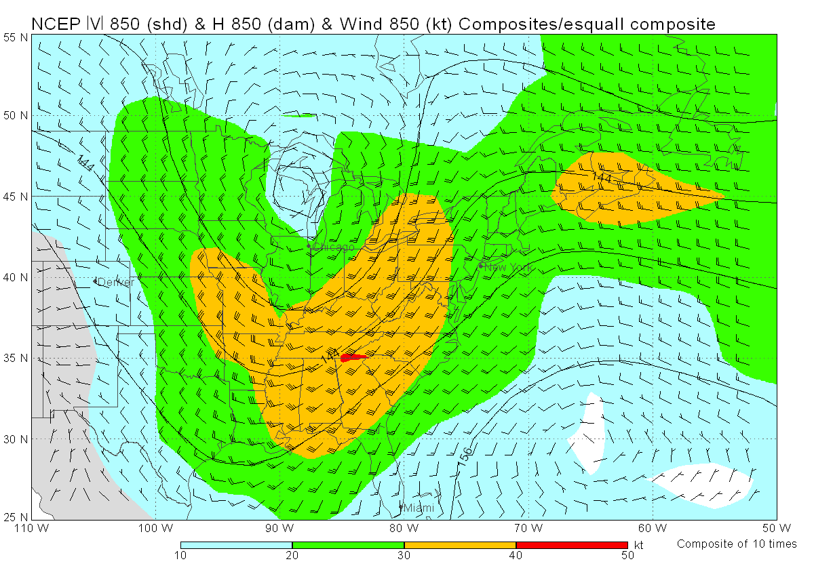
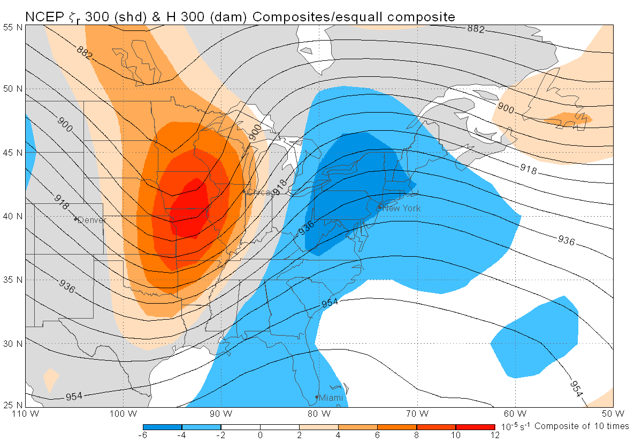
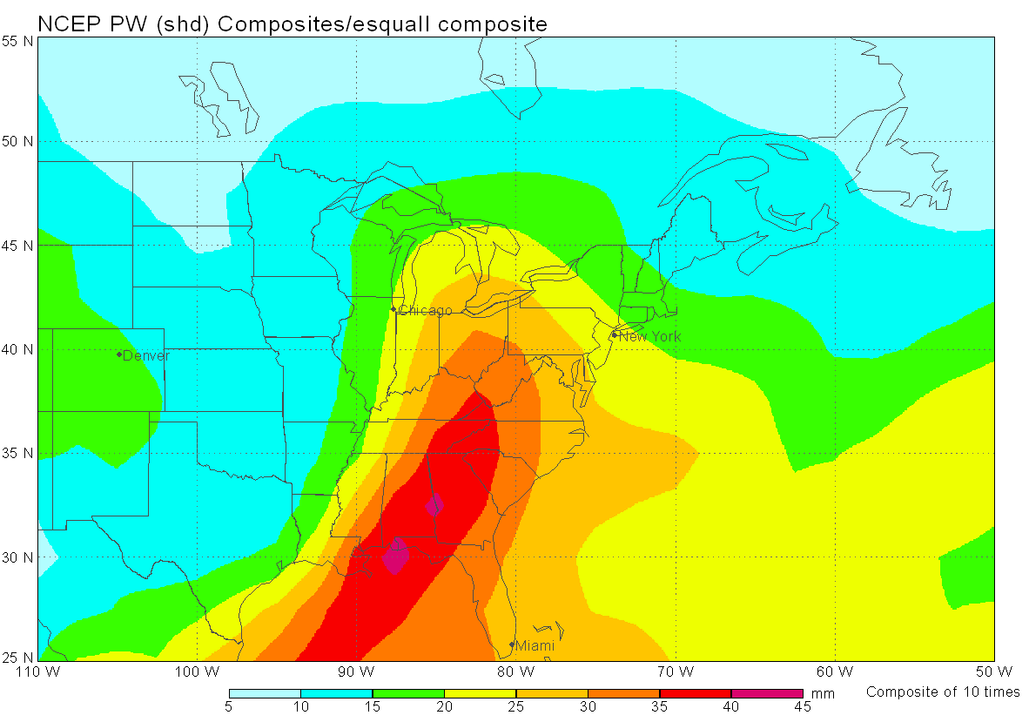
Eastbound Squall
Synoptic Weather Characteristics (Continued)

Slide 7
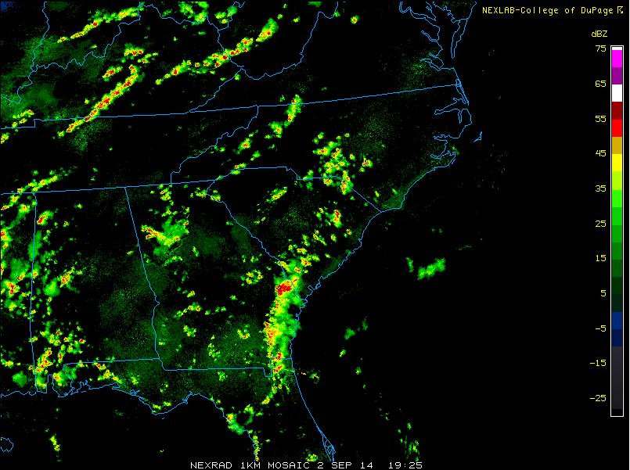
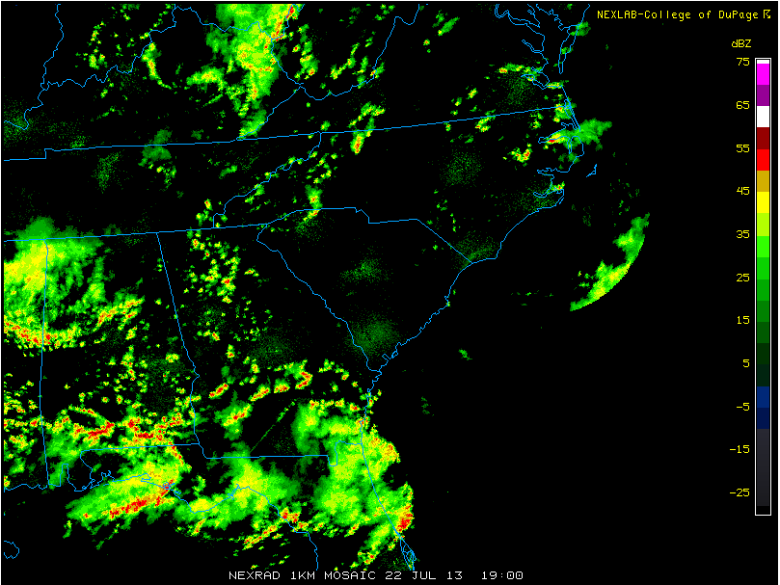
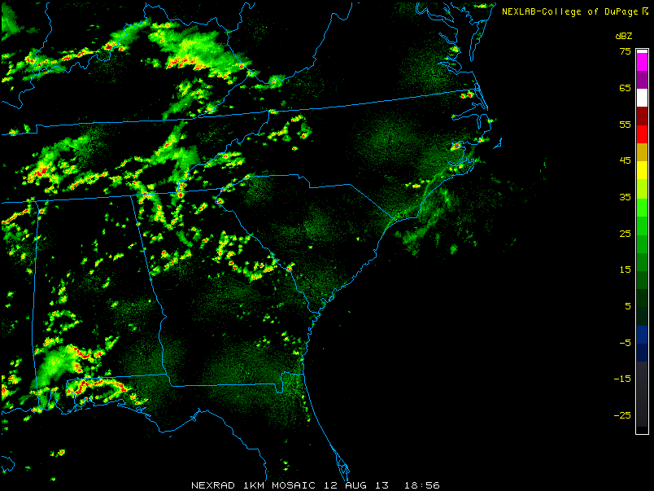
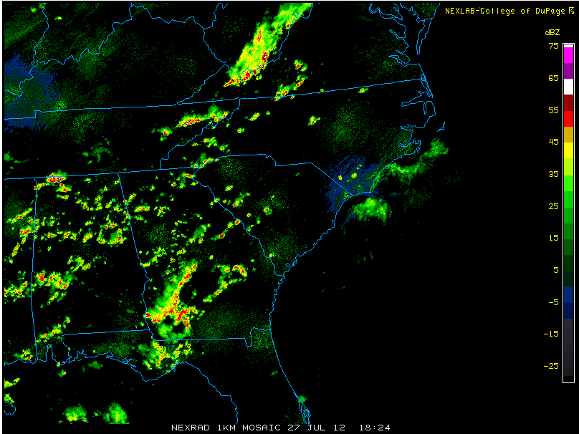
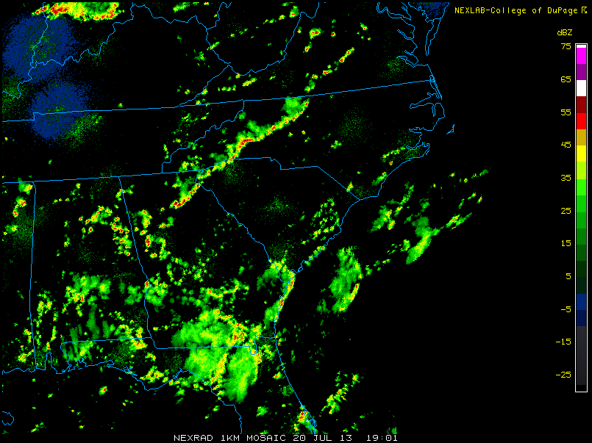
Eastbound Scattered
Synoptic Weather Characteristics
116 Delays
262 Delays
265 Delays
445 Delays
270 Delays

Slide 8
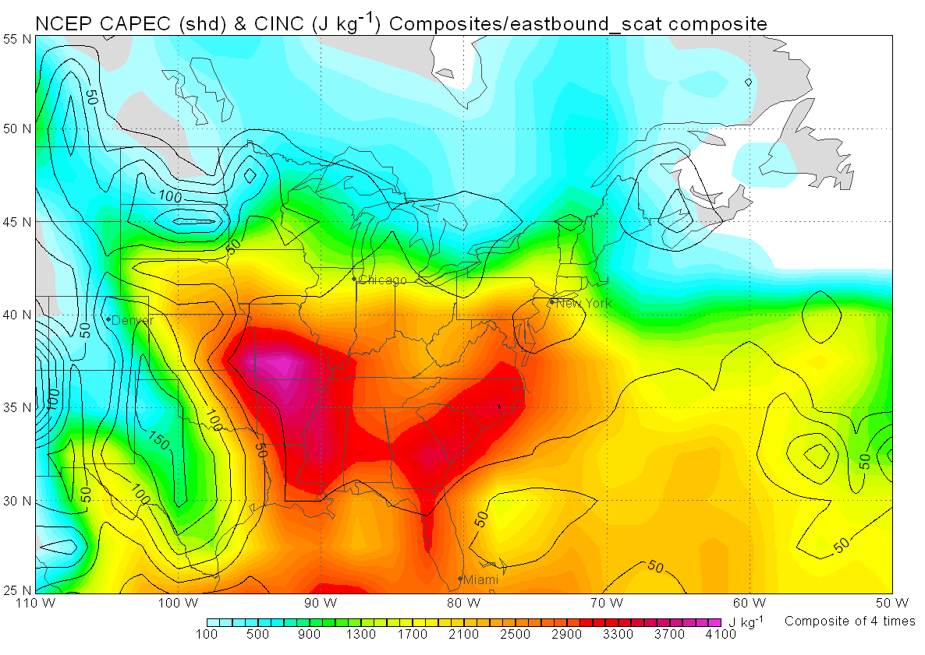
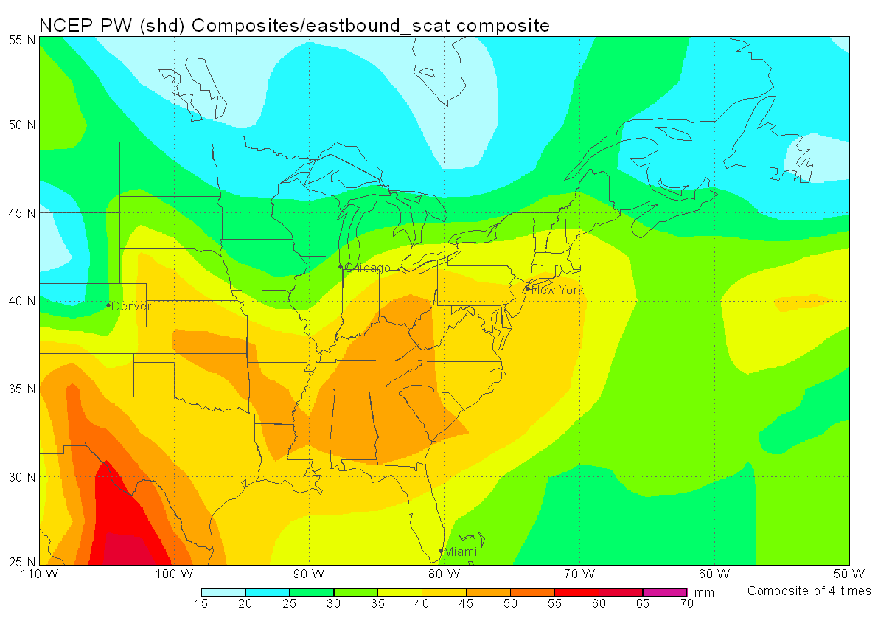
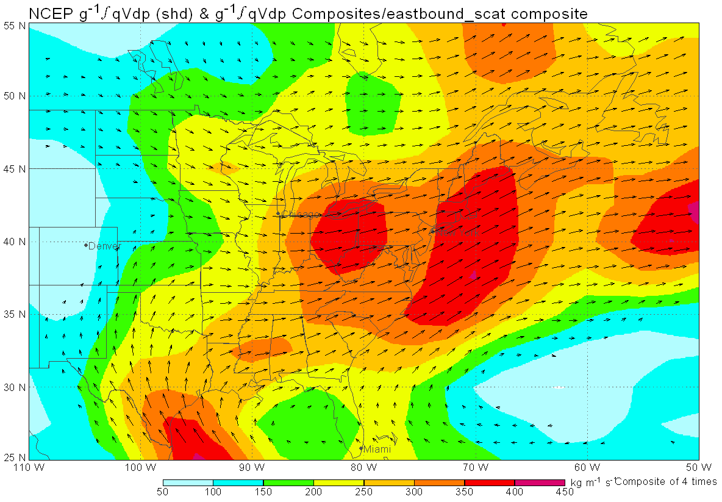
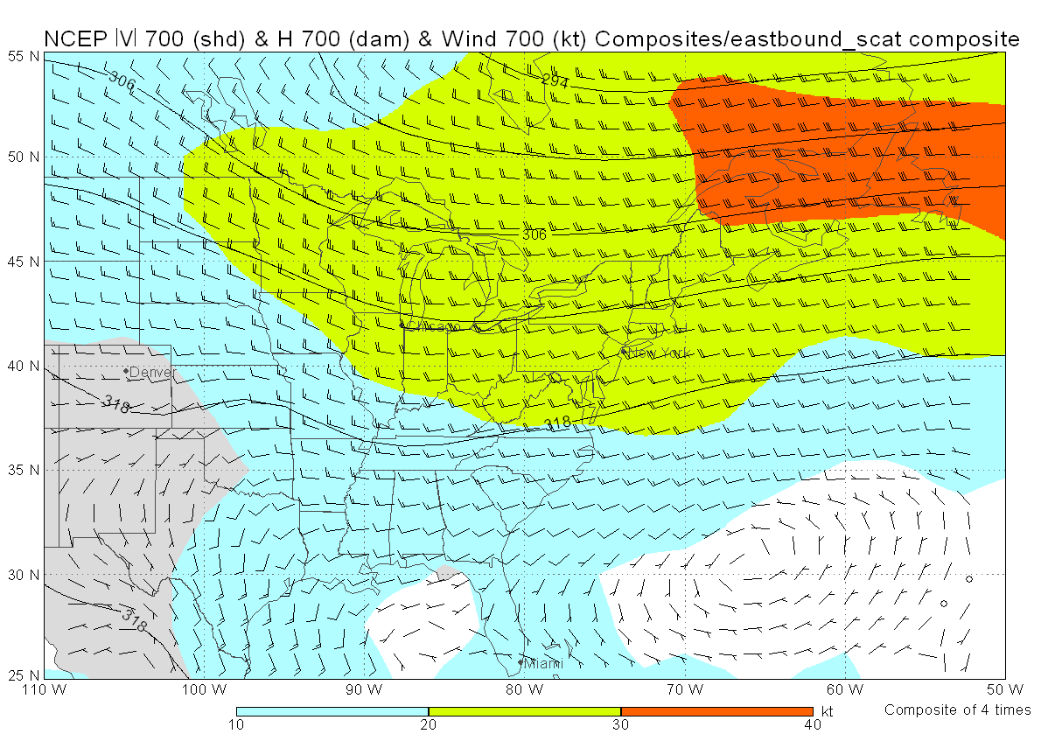
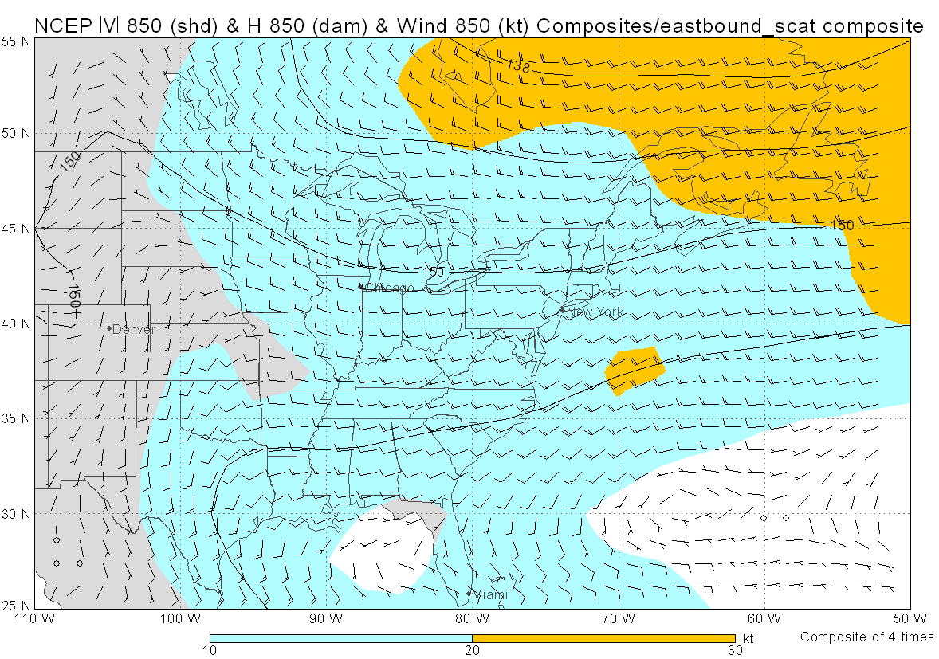
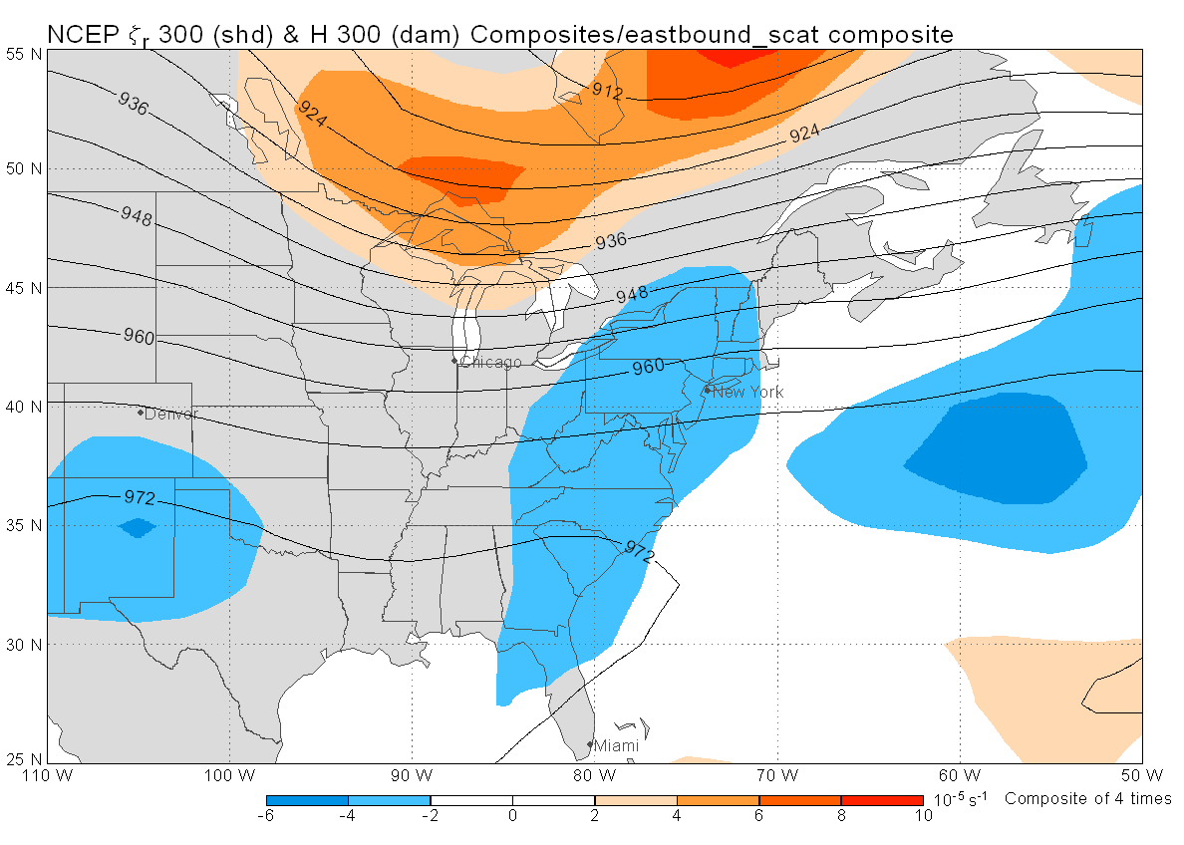
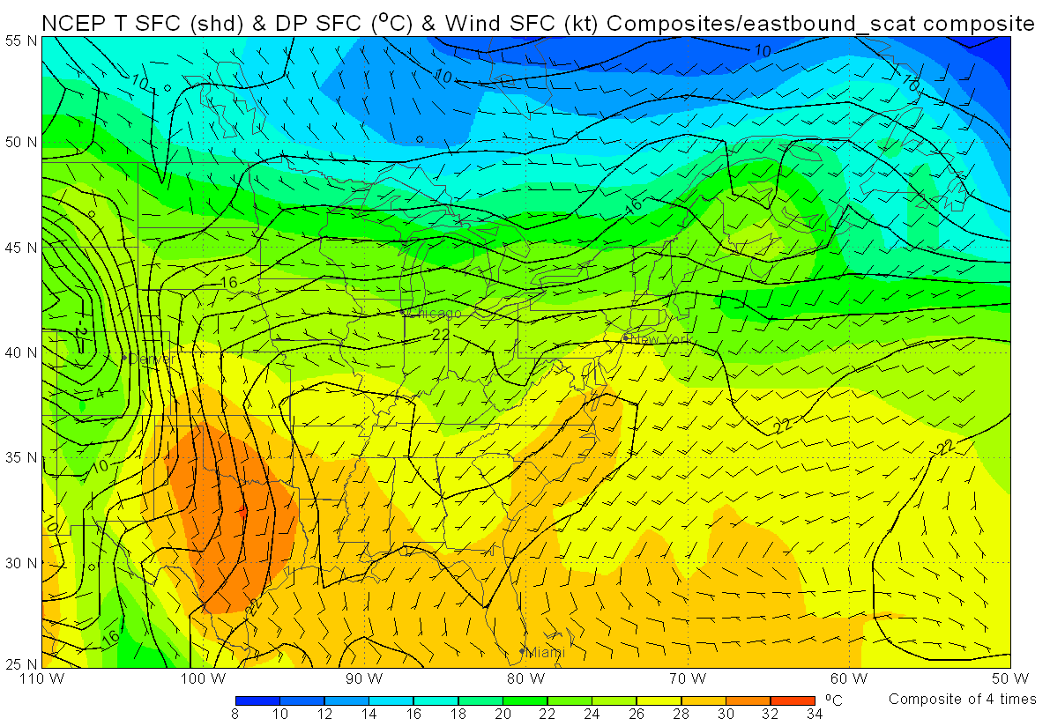
Eastbound Scattered
Synoptic Weather Characteristics (Continued)

Slide 9
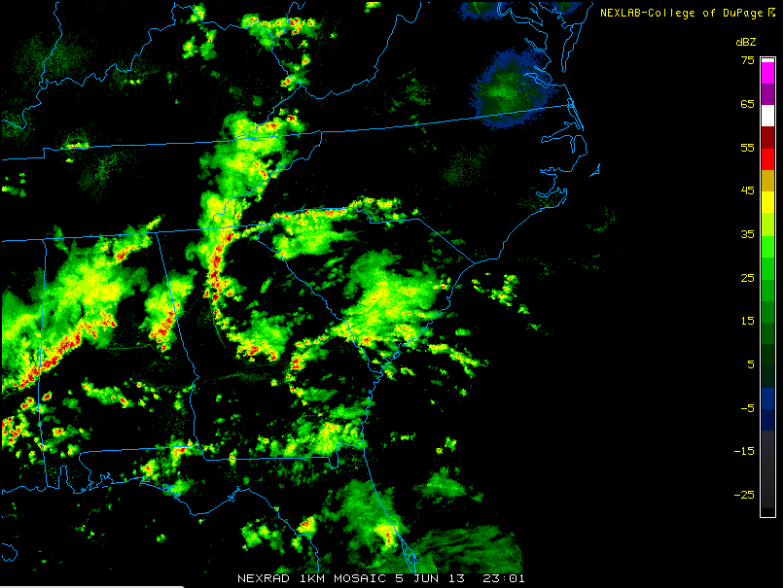
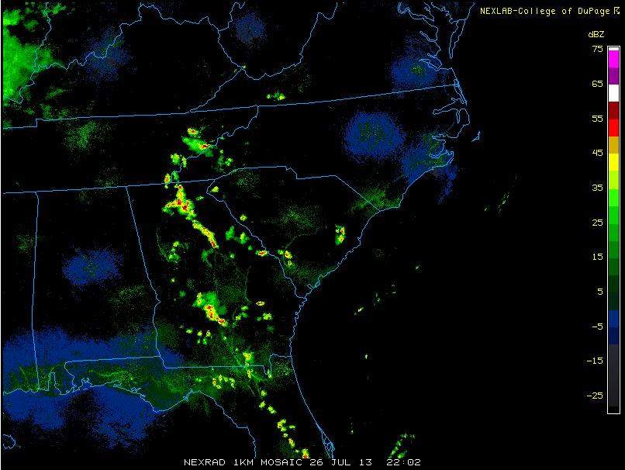
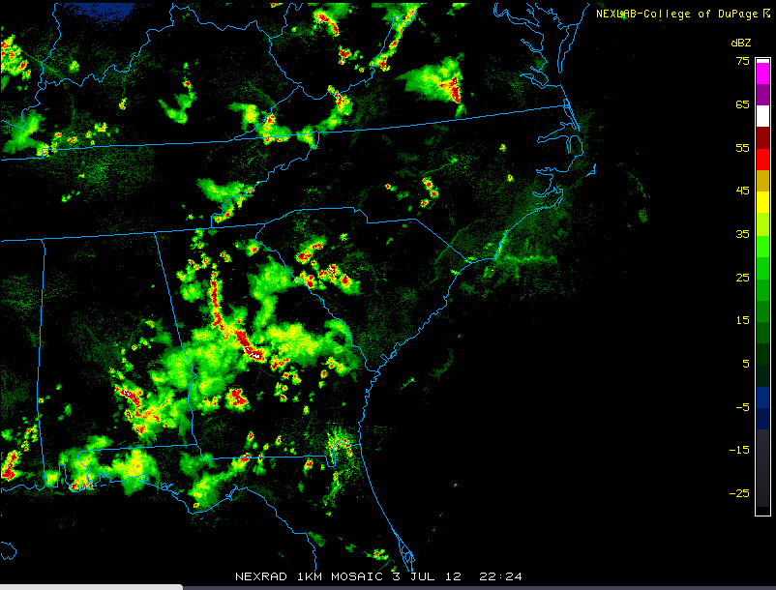
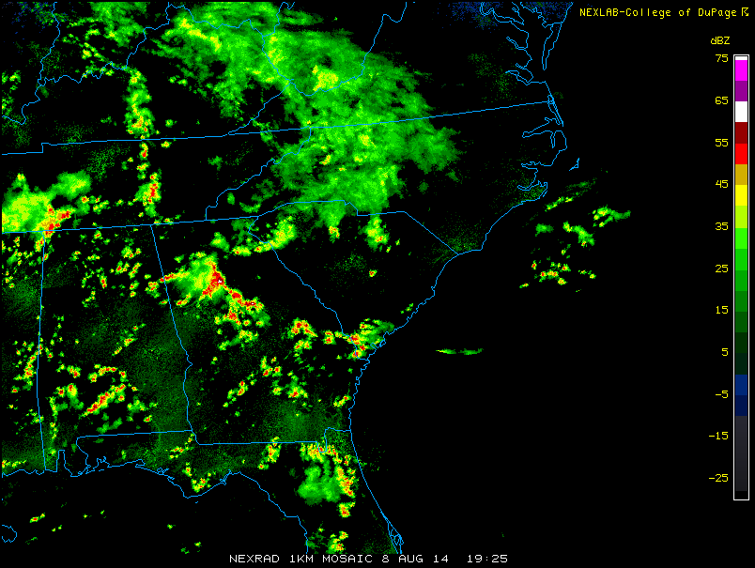
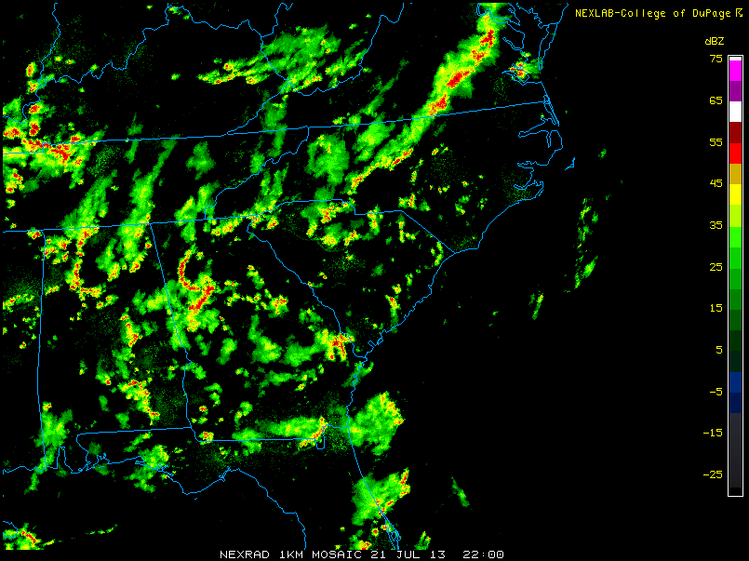
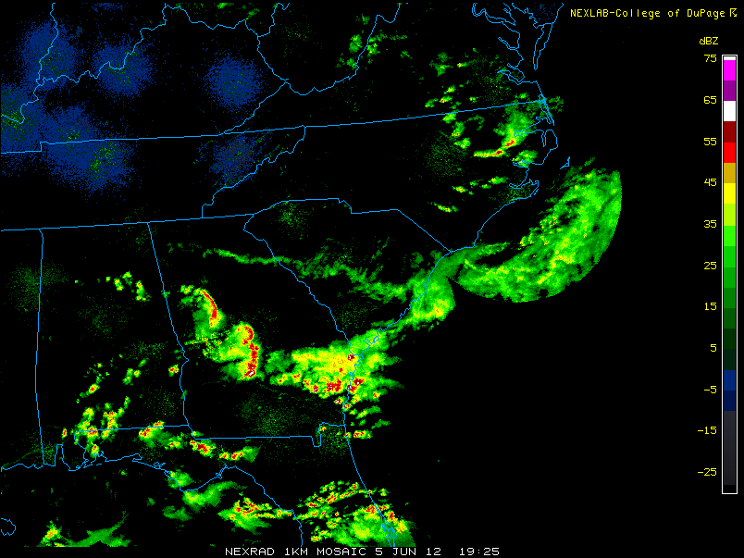
Eastbound Organizing
Synoptic Weather Characteristics
498 Delays
326 Delays
247 Delays
399 Delays
537 Delays
109 Delays

Slide 10
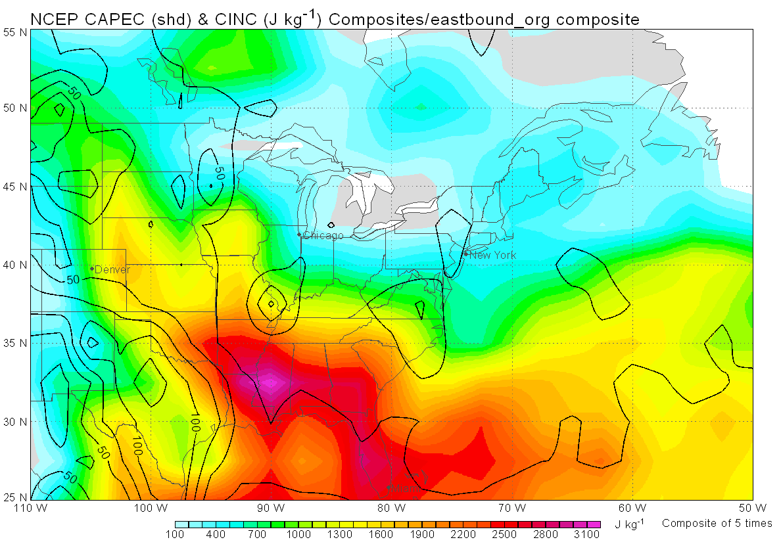
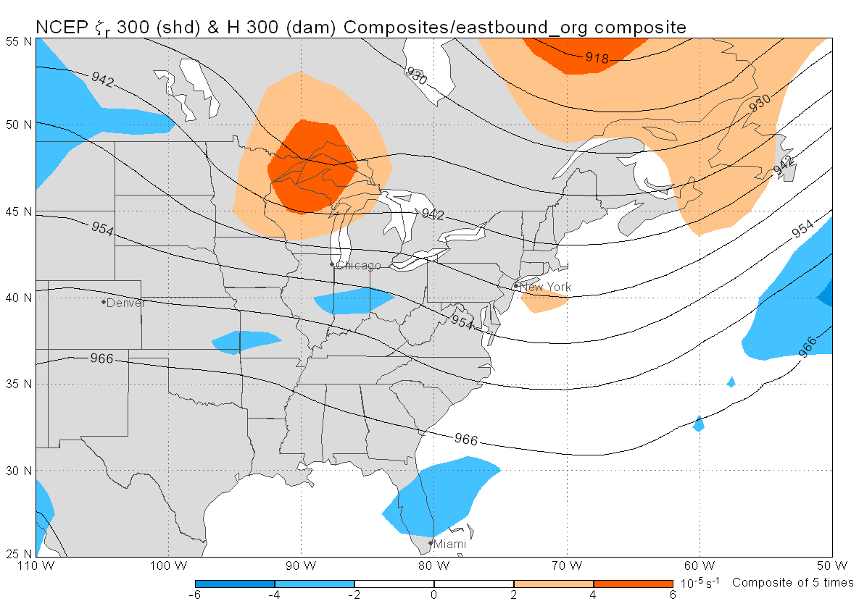





Eastbound Organizing
Synoptic Weather Characteristics (Continued)

Slide 11




Northbound Organizing
Synoptic Weather Characteristics
353 Delays
123 Delays
283 Delays
260 Delays

Slide 12







Northbound Organizing
Synoptic Weather Characteristics (Continued)

Slide 13



Inconsistencies
Synoptic Weather Characteristics
194 Delays
924 Delays
710 Delays

Slide 14
Questions ??

Slide 15
Work Cited
Diem, Jeremy E. "American Meteorological Society." Synoptic-Scale Controls of Summer Precipitation in the Southeastern United States: Journal of Climate: Vol. 19, No 4. American Meteorological Society, 15 Oct. 2004. Web.
Diem, Jeremy E., and Thomas L. Mote. "Interepochal Changes in Summer Precipitation in the Southeastern United States: Evidence of Possible Urban Effects near Atlanta, Georgia." Journal of Applied Meteorology J. Appl. Meteor. 44.5 (2005): 717-30. Web.
Diem, Jeremy E. "Comments on “Changes to the North Atlantic Subtropical High and Its Role in the Intensification of Summer Rainfall Variability in the Southeastern United States”." Journal of Climate J. Climate 26.2 (2013): 679-82. Web.
Konrad, Charles E. "Synoptic-Scale Features Associated with Warm Season Heavy Rainfall over the Interior Southeastern United States." Wea. Forecasting Weather and Forecasting 12.3 (1997): 557-71. Web.
Robinson, Peter J. "The Influence of Weather on Flight Operations at the Atlanta Hartsfield International Airport." Wea. Forecasting Weather and Forecasting 4.4 (1989): 461-68. Web.
*All Composites were composed using the Meteorological Analysis and Diagnosis Software.

Slide 16
Special Thanks
Dr. Curtis James, ERAU
Greg Juro, FAA
Dr. Gary Yale, ERAU
This research was funded by the NASA Space Grant

